Slide 1

Tire Defects Detection
Chrishan Bastiampillai – 249289D
Applied Machine Learning
University of Moratuwa
01/15/2026

Slide 2
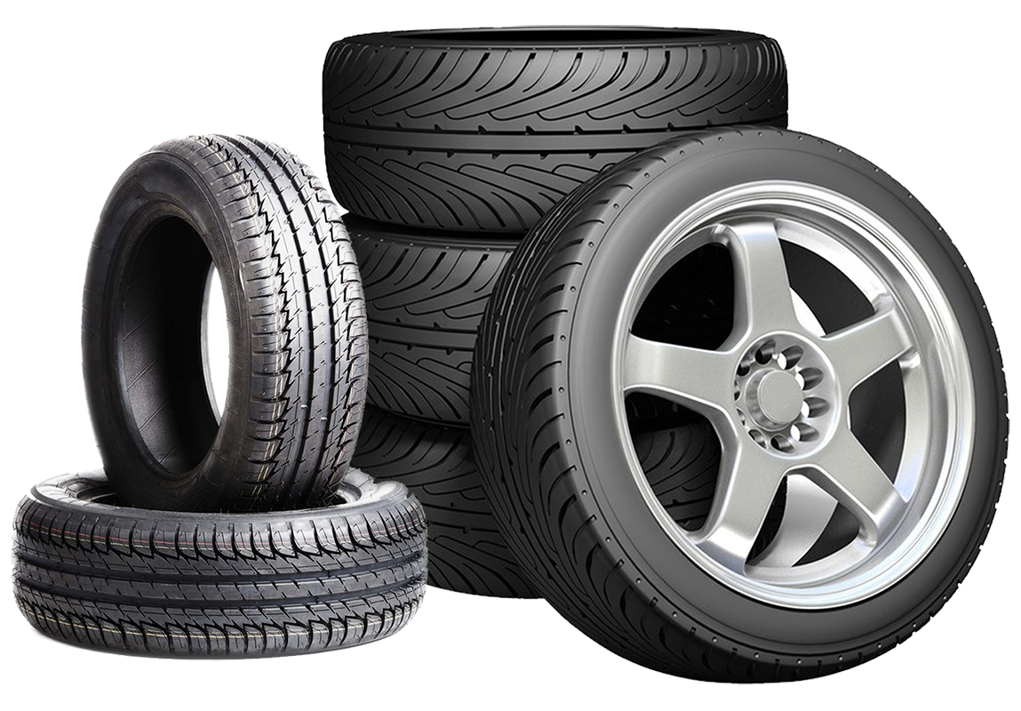
Problem Statement

Slide 3
Problem Statement
Tire defects are rare but costly—traditional inspection methods struggle to detect them early and consistently.
To address this challenge, we introduce a data-driven solution that improves defect detection accuracy while supporting informed quality-control decisions.
This approach demonstrates how explainable machine learning can enhance reliability and trust in industrial quality control.

Slide 4
Data & Model Overview

Slide 5
Data & Model Overview
Data
Features
Model
~12,000 Tire Records
Process Parameters
Tree-based ensemble (Gradient Boosted Trees)
Environmental Condition
8,402 Training
1,818 Validation
Physical Measurements
1780 Test
~7% Defect Rate

Slide 6
Model Performance

Slide 7




Model Performance
Test Accuracy
Precision
Recall
F1 Score
87.98%
12.04%
9.85%
10.83%
Performance reflects realistic industrial class imbalance.

Slide 8
Explainability & Insight

Slide 9

Explainability & Insight
SHAP was used to explain model Prediction
Top drivers of defect
  Cure Temperature
  Ambient humidity
  Tire Weight
  Uniformity Metrics
Predictions align with manufacturing domain knowledge

Slide 10

Thank You

